Slide 1
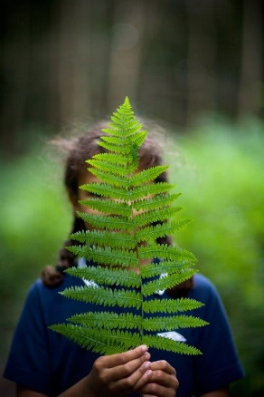
Future Footprints:
Promoting sustainable practice in/through Outdoor Education*
*This use of term can be adapted to suit an organisation/context
The What?
The So What?
and,
The Now What?

Slide 2
Key Definitions
The What?
Sustainability:
Meeting the needs of the current generations without compromising the ability
of future generations to meet their needs.
Biodiversity
The variety of all living things on Earth and how they fit together in the web of life bringing Oxygen, water, food and countless other benefits.
Carbon Neutral:
Where the carbon emissions caused by human activity are either completely removed or have been balanced out by carbon savings elsewhere

Slide 3
Issues with Biodiversity?
The UK is one of the world's most nature-depleted countries - in the bottom 10% globally and last among the G7 group of nations, 2021 data shows.
It has an average of about half its biodiversity left, far below the global average of 75%, a study has found.
A figure of 90% is considered the "safe limit" to prevent the world from tipping into an "ecological meltdown", according to researchers.
The UK's low position in the league table is linked to the industrial revolution, which transformed the landscape, the researchers said.
Biodiversity loss risks 'ecological meltdown' - scientists - BBC News

Slide 4
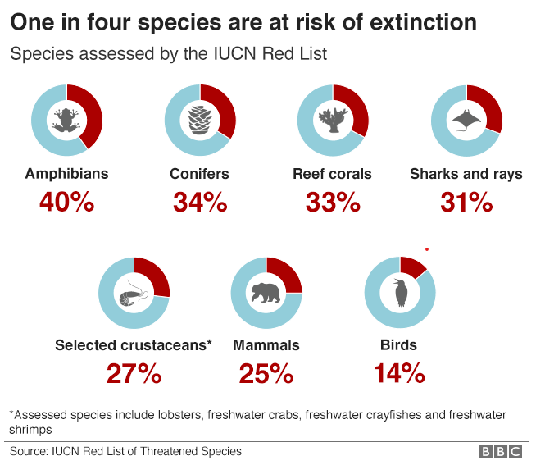
Global Biodiversity
The Living Planet Index (LPI) is a measure of the state of global biological diversity based on population trends of vertebrate species from around the world.

Slide 5
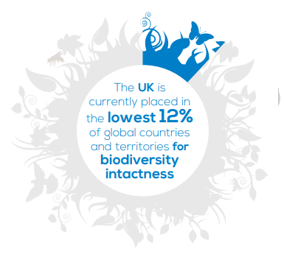
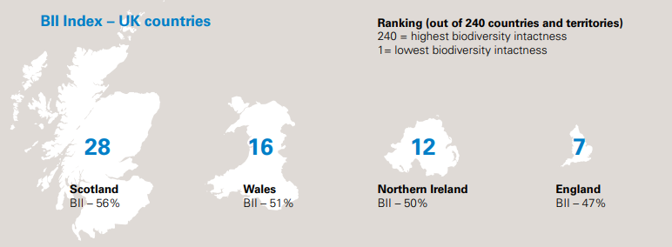
48398rspb-biodivesity-intactness-index-summary-report-v4.pdf

Slide 6
What is Climate Change?
Climate Change (generally): the long term change in global temperatures and weather.
Climate change (20th/21st century specifically): the rapid change in global temperatures and weather largely due to increased carbon dioxide emissions from the burning of fossil fuels.
Burning fossil fuels
Releases carbon dioxide into the atmosphere
CO₂ is known as a ‘greenhouse gas’ meaning that when released it becomes trapped in the upper layer of the atmosphere and it warms the planet

Slide 7
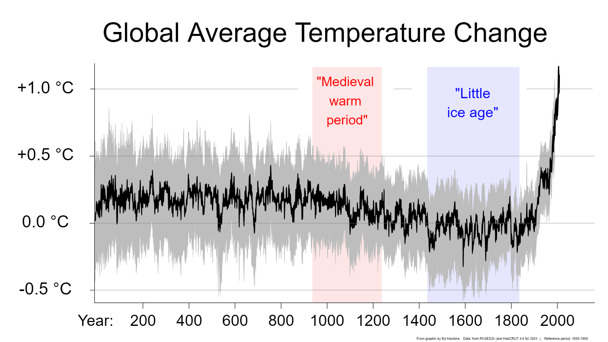
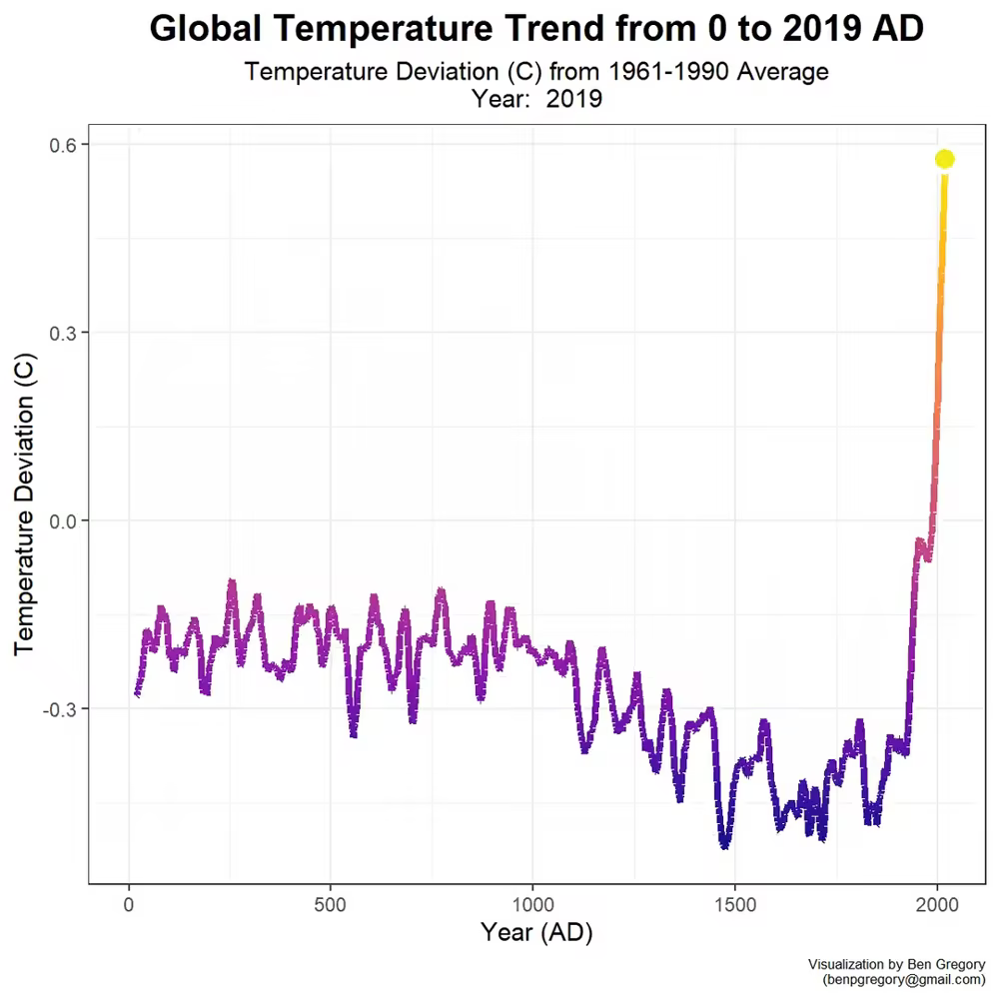
What is Climate Change?
Notes:
A fact that is less well known is that the has gone through periods of extreme warm and extreme cold in the Earth’s geologic history. However, there are two key caveats to remember when considering this. Firstly, extreme temperatures have never been experienced while humans have been on Earth. Secondly, even the ‘warm’ and ‘cold’ periods have been small changes in comparison to the temperature rise that we have seen in the last 70 years from the burning of fossil fuels (as can be seen in the graphs here).

Slide 8
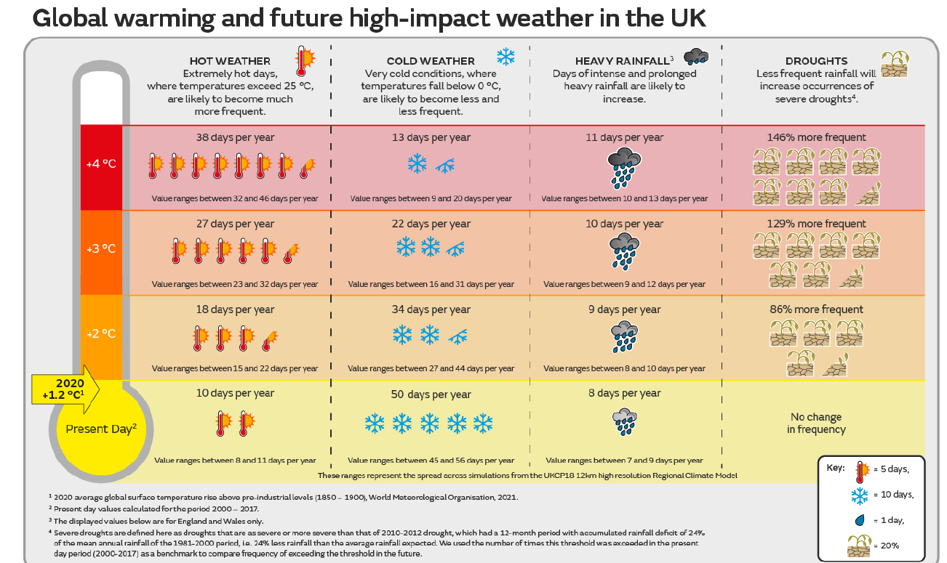
Net Zero by 2050 required to stay under 2 degrees Celsius average global temperature

Slide 9
Young people’s climate anxiety revealed in landmark survey – September 2021
The
So What?
The survey — the largest of its kind — asked 10,000 young people in 10 countries how they felt about climate change and government responses to it.
Climate change is causing distress, anger and other negative emotions in children and young people worldwide, this survey of thousands of 16- to 25-year-olds has found.
This ‘eco-anxiety’ has a negative impact on respondents’ daily lives, say the researchers who conducted the survey, and is partly caused by the feeling that governments aren’t doing enough to avoid a climate catastrophe.
Young people’s climate anxiety revealed in landmark survey (nature.com)

Slide 10
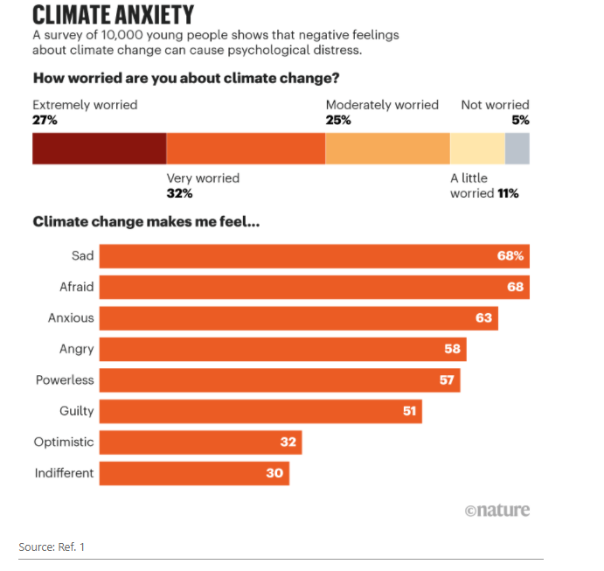
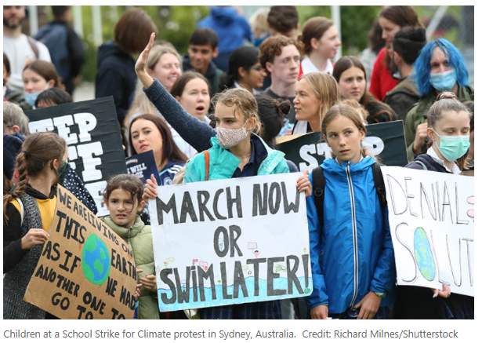
A general ‘othering’
Among those children who said they have talked to others about climate change (81%), nearly half reported being ignored or dismissed.
“There is a general ‘othering’ of children in society, and children’s voices that threaten the predominant narrative of the most powerful group in society,” says study co-author Caroline Hickman, a climate-psychology researcher at the University of Bath, UK.
Until now, there has been little research on the psychological impacts of climate change on children, she adds.

Slide 11
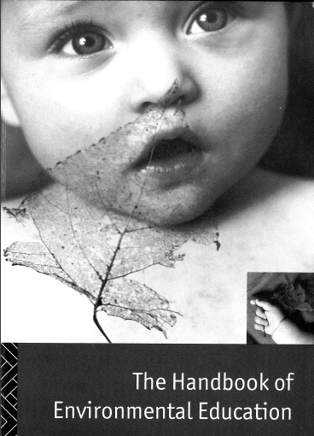
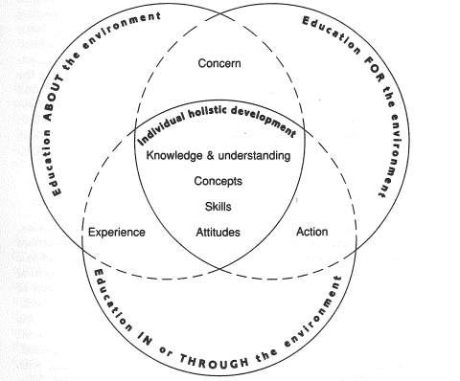
High Quality Outdoor Learning
Joy Palmer & Philip Neal 1994

Slide 12
The Now What?
The Future Footprints Promise
We agree to take part in the Future Footprints project.
Insert name of Centre/Organisation
Our ambition is to develop an ethos of shared responsibility so that all individuals involved
in our organisation actively engage with, and contribute effectively towards, achieving
environmental sustainability for the future of our planet.
Date: (insert)

Slide 14
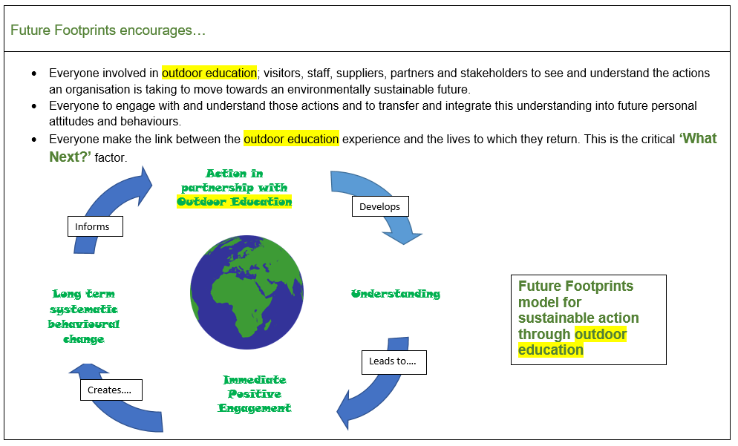

Slide 15
Audit & Review
Action Planning
Audit & Review
Keep Going to 2030!

Slide 16
1 Waste management
Key Task/Action | Who leading? | Who can help us? | Target Date? | Achieved? Dates and notes | Education links / Communication Strategy?
1.1
1.2
1.3

Slide 17
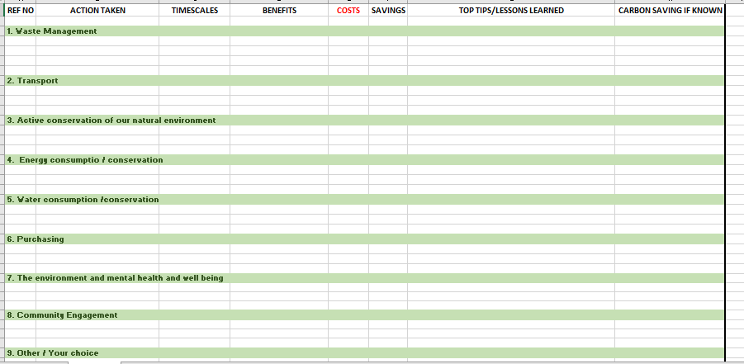
Bank of Proven Practice

Slide 19
Calculating your Carbon
Individual:
WWF Footprint Calculator
or
Carbon Footprint Calculator - Recommended by the Climate Champions | Giki Zero
Organisational:
Greenhouse Gas Accounting Tool - Local Partnerships

Slide 20
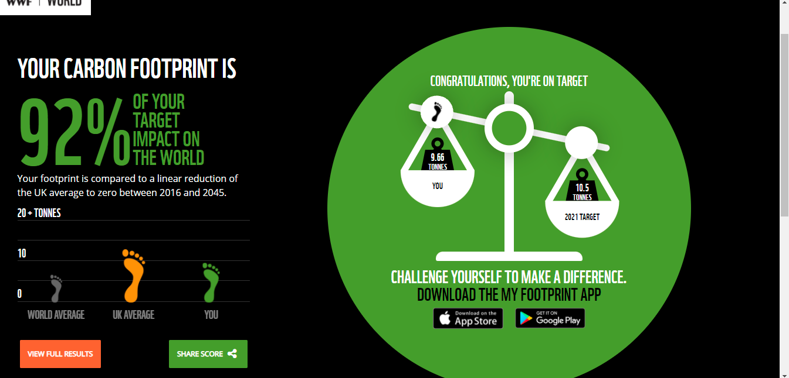
Calculating your Carbon

Slide 21
Communication/ Education Links

Slide 22
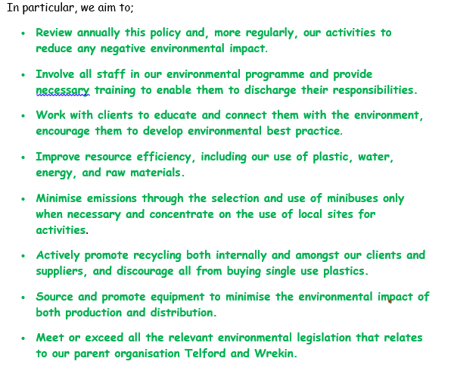
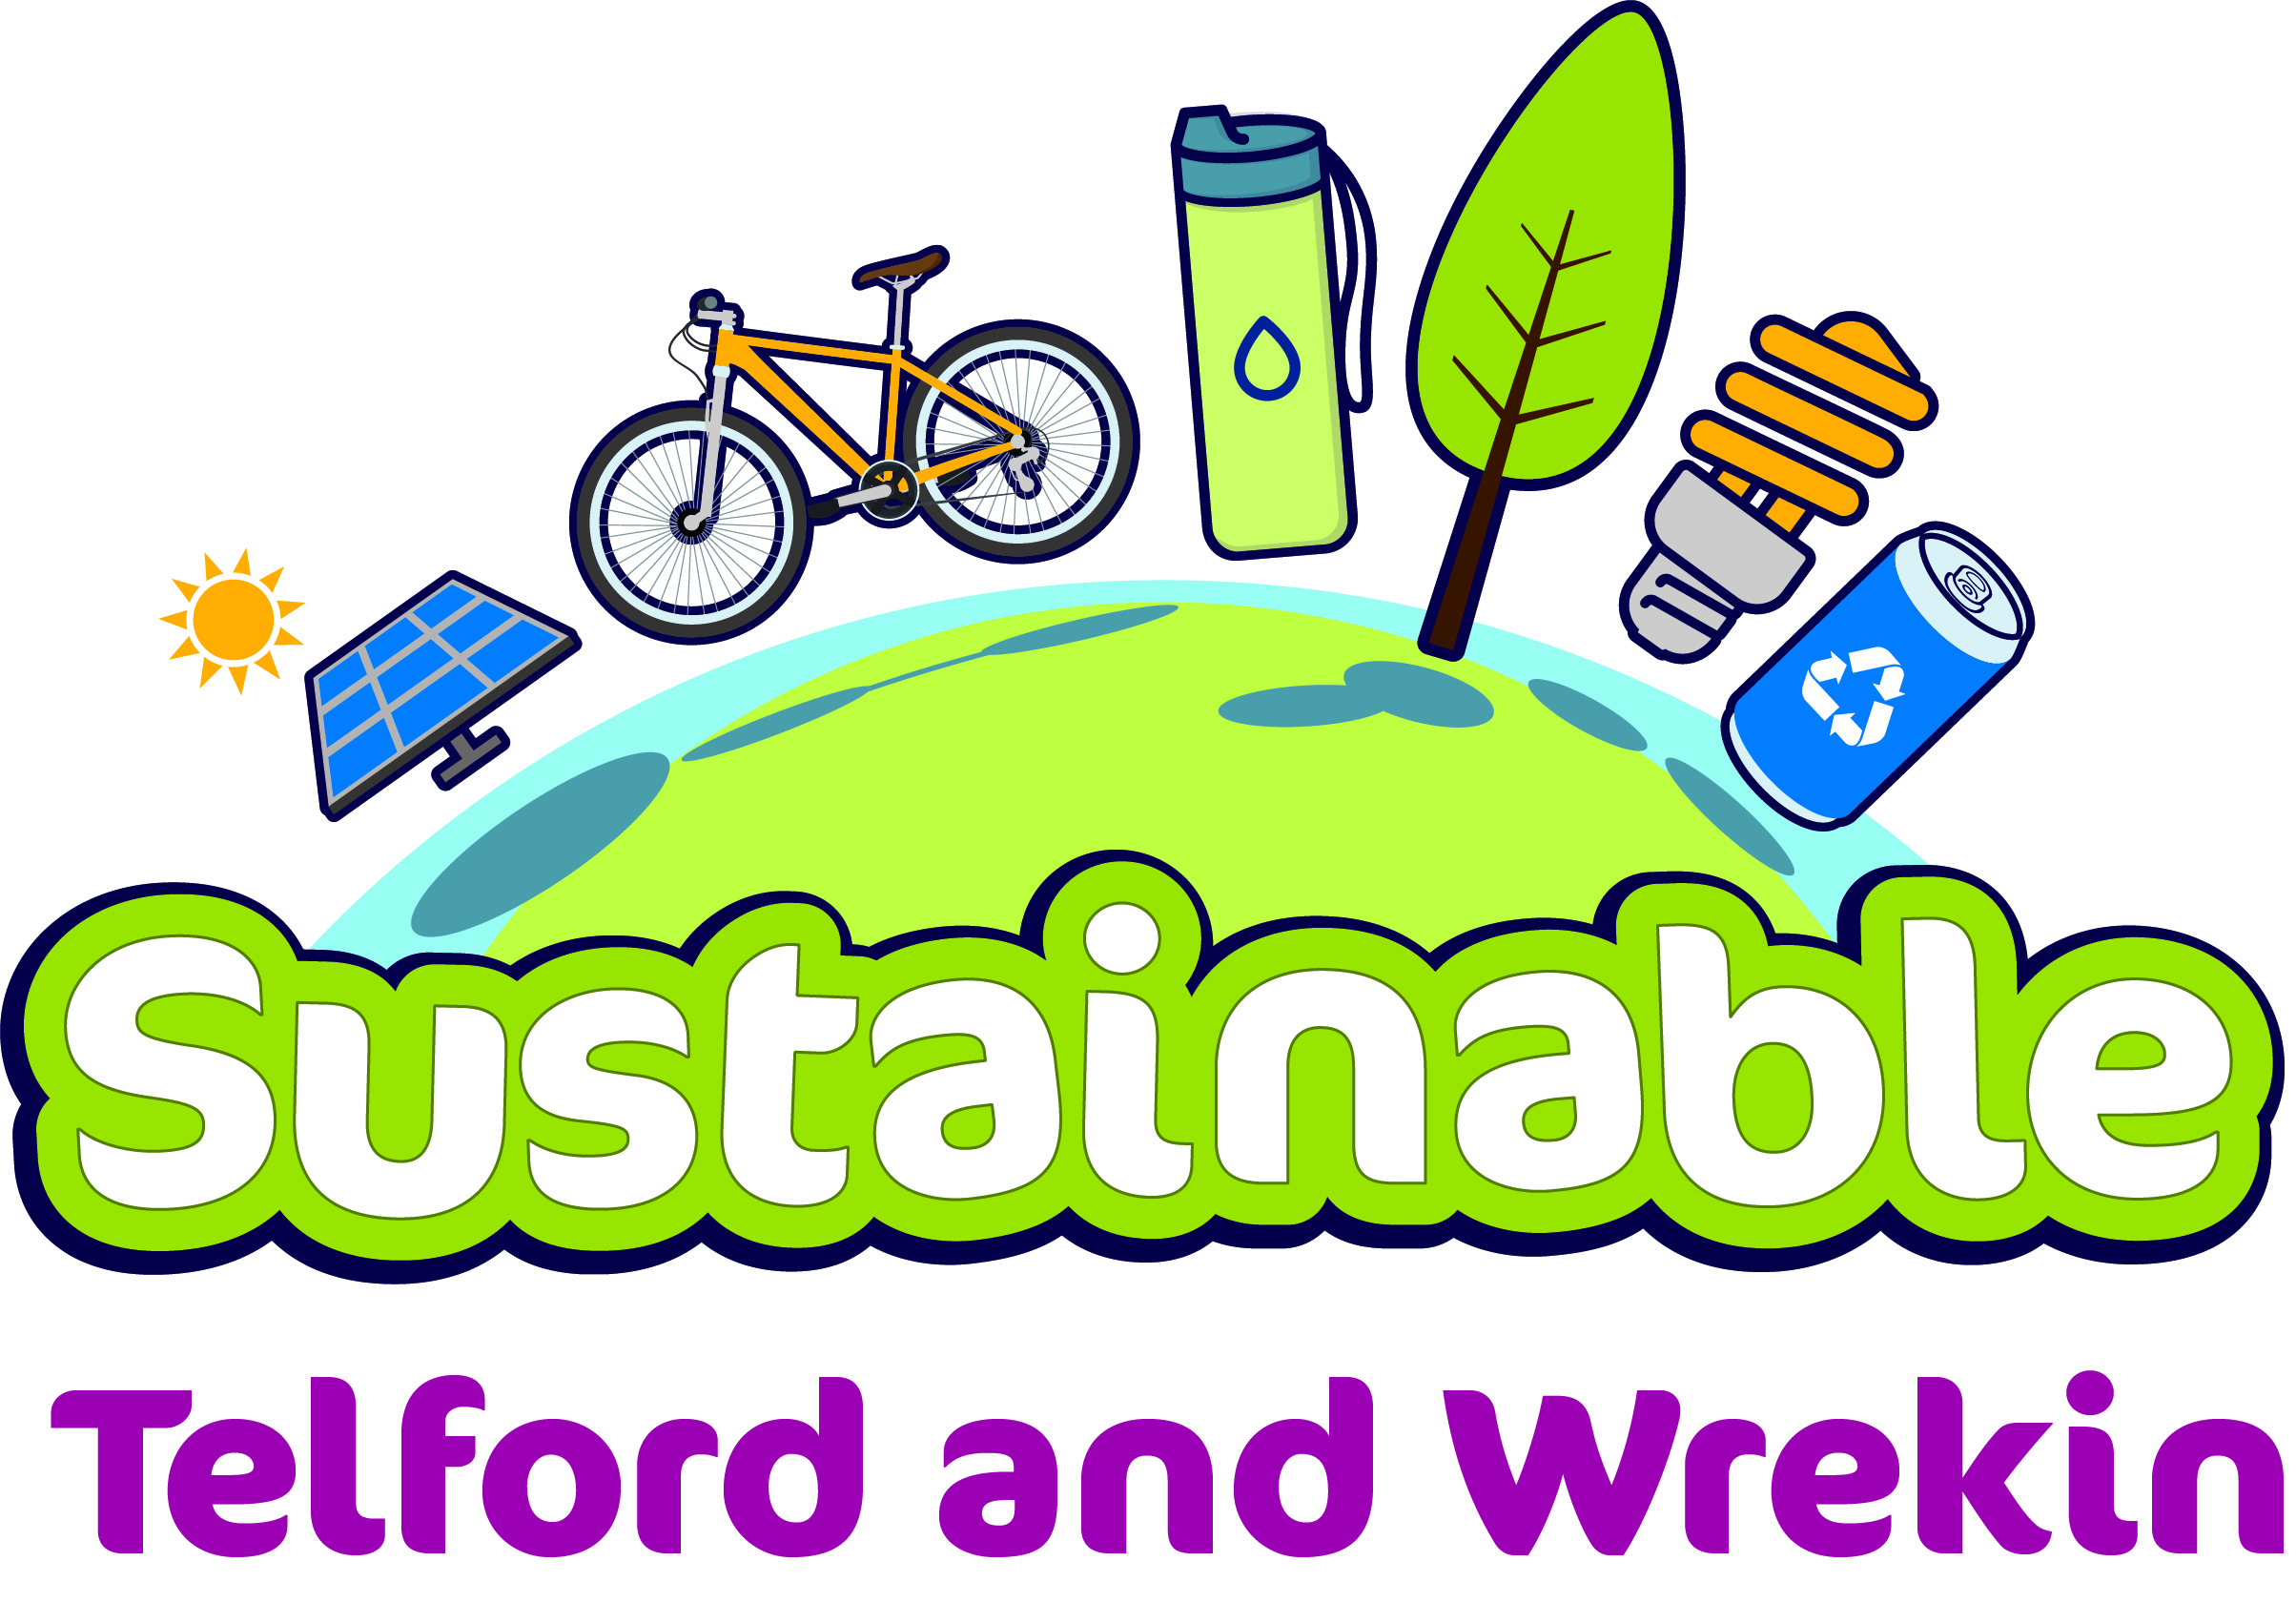
Communication/ Education Links

Slide 23
Going forwards….??? …..Lightening the load
Share future Footprints
Build bank of proven practice
Carbon calculators
Web based ‘pack’ – with explanatory
detail, resources and signposting
environmentalstewardship@outdoor-learning.org
https://www.outdoor-learning.org/Good-Practice/Good-Practice/Future-Footprints

Slide 24
Case Study
Plas Gwynant Outdoor Education Centre
Plas Gwynant became an Eco centre in 2008 and remained so until the scheme came to an end. By this time the ethos and ideas had become so entrenched in the everyday life of the centre that the staff decided on an informal rebrand, incorporating a big green thumb as its symbol. Whilst ‘under the thumb’, we continued efforts to reduce our environmental footprint across all aspects of the centre’s operations from food waste and recycling to electricity and travel, water and gas.
The centre is nestled in the Gwynant valley surrounded by land owned by the National Trust and on the door step of the thriving Nant Gwynant and Beddgelert villages. We’re always felt that engagement with community partners is an essential part of our activities with groups. As providers of the John Muir Award we’ve worked on the Beddgelert community garden and tree nursery, dry-stone walled and rhododendron pulled with the National Trust and adopted a section of footpath that runs down the valley on Trust land.
Lockdown and an absence of groups gave us an opportunity to re-think and re-structure our efforts, from which was born the idea for Future Footprints. Our goal is to promote positive long-term environmental behaviour in young people through engagement in systematic action, supported by effective education.

Slide 25
We recognise the scale of the challenges facing us but we’ve always felt that if we can get young people to do the basics (lights, waste, water, recycling) and relate that to the outdoor environment from which they take their positive experiences; then there is a chance that those behaviours will become entrenched.
Our successes and our frustrations abound in equal measure. One week the recycling and composting are perfect, the children turn off lights when they leave their bedrooms and there is very little food waste recorded in the ‘ORT’ report at the end of each meal. The next week the dormitories can be lit up like a shopping centre at Christmas time, the compost bin full of litter and someone walks off leaving a tap running in toilet. Time has brought about the realisation that no one way is perfect and we’ve tried every combination of systems and actions imaginable, to establish a desire to engage.
We’ve recently re-doubled our efforts by bringing in more systematic bedroom tidiness competitions incorporating recycling and waste management; further developing our centre jobs the groups do each morning, and continuing to reinforce messages at key times such as morning briefings and visiting staff meetings.
It’s a long road but we feel that if only one young person choses to dispose of their rubbish responsibly, turn off the lights and not spend 10 minutes in the shower in the future, then it is worth the effort.
Dan Jackson

