Slide 1
Greenhouse Gas Accounting Tool

Slide 2
Greenhouse Gas Accounting Tool
What is it?
A template that can be used to record emissions
The Greenhouse Gas Accounting tool automatically links your data with the relevant UK Government Conversion Factors
What is it for?
Knowing if your interventions have made a difference
Providing you with a robust and reviewed tool to calculate and store baselines and the outputs

Slide 3
“Scopes” measured
Scope 1 emissions are direct GHG emissions from operations that are owned or controlled by the reporting company (e.g. emissions from fuel consumed by minibuses at our centres).
Scope 2 emissions are indirect emissions from the generation of purchased energy consumed by a company (e.g. emissions from electricity your centre buys from the grid for use on site).
Scope 3 emissions are all other indirect emissions (not included in Scope 2) that occur in the value chain of the reporting company (e.g. emissions from the disposal waste that is generated).

Slide 4
CO2e
CO2e is the shorthand for carbon dioxide equivalents. It is the standard unit in carbon accounting to quantify greenhouse gas emissions.
One tonne of carbon dioxide has become the standard unit for greenhouse gases and emissions of gases other than carbon dioxide are converted according to their global warming potential.
CO2e was an important breakthrough in finding climate change policy and solutions for global warming because it provides a standard unit that can be measured and is agreed to by all stakeholders.

Slide 5
CO2e
1x
Carbon dioxide
Nitrous oxide
Sulphur hexafluoride
Tropospheric ozone
Chlorofluorocarbons (CFCs)
Hydrochlorofluorocarbons (HCFCs)
Methane
12x
114x
270x
3200x
Notes:
Sulfur hexafluoride: voltage electrical insulation, Nitrous oxide commonly known as laughing gas. HCFCs’ refrigerants and for making plastic foams

Slide 6
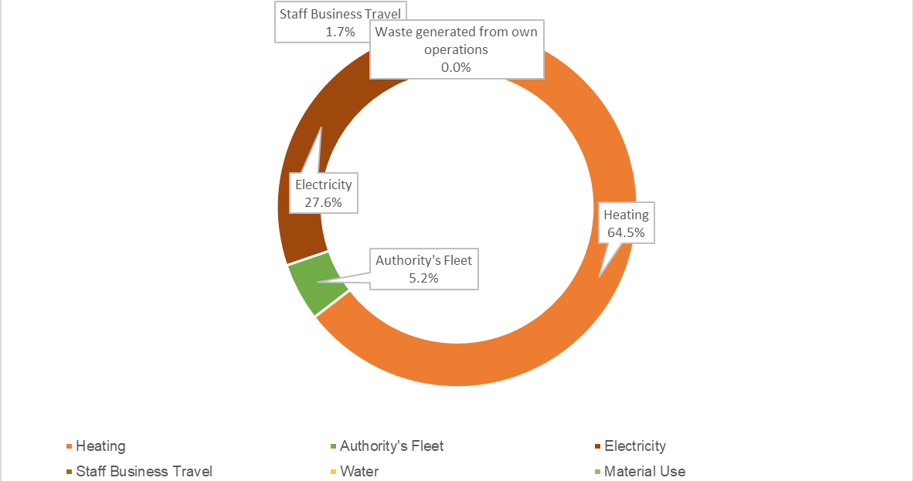

Slide 8
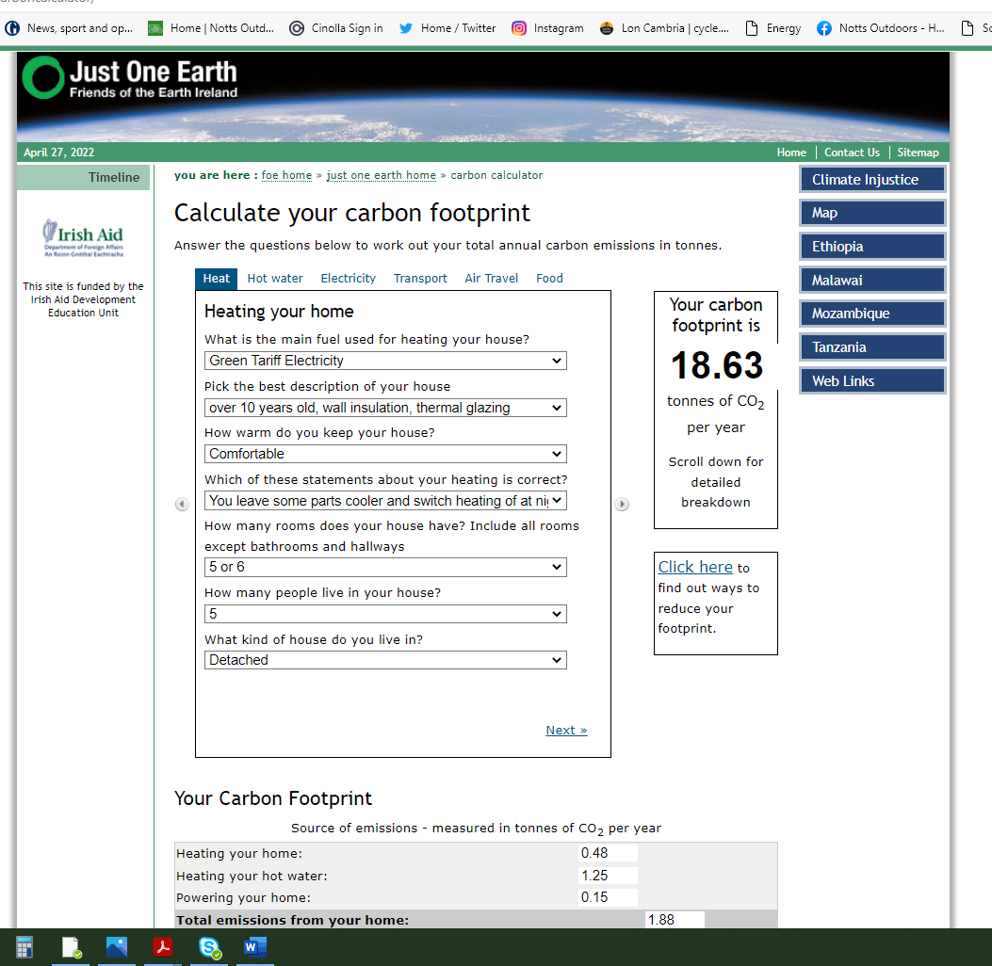
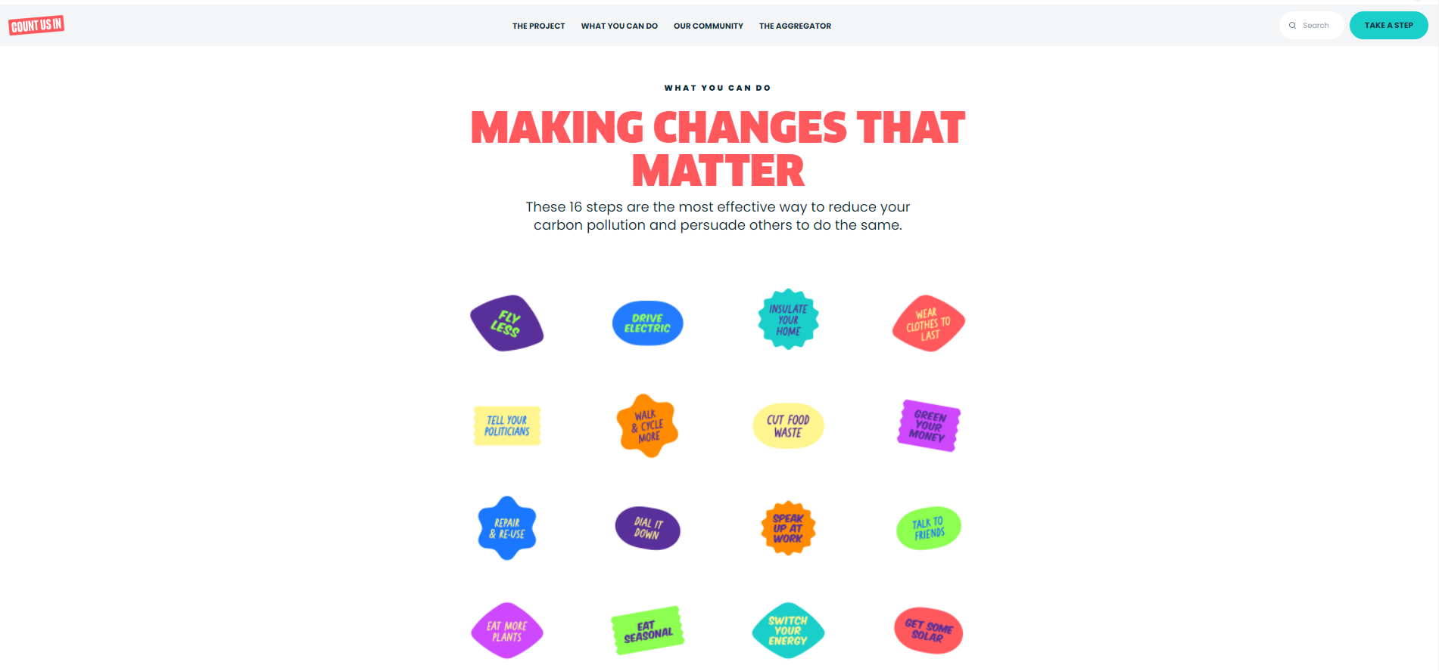
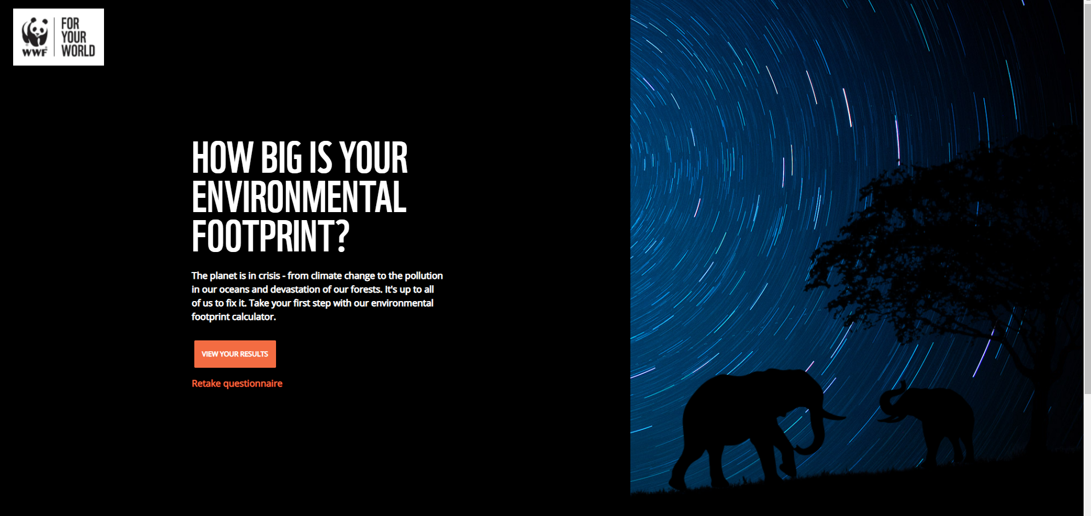
Individual Choices
Calculate your carbon footprint | Just One Earth (foe.ie)
WWF Footprint Calculator
What You Can Do | Count Us In (count-us-in.org)

Slide 9
Greenhouse Gas Accounting Tool - Local Partnerships
https://localpartnerships.org.uk/greenhouse-gas-accounting-tool/

